Slide 1
Hadoop Distributed File System
Tseng-Ching James Shen, PhD

Slide 2
Agenda
HDFS Data Sharding
Installation of Hadoop
HDFS Architecture
HDFS Shell Commands
HDFS Java API
HDFS High Availability
Hadoop: The Definitive Guide, Tom White, 2015 O’Reilly Media, Inc.

Slide 3
HDFS Data Sharding
Each file is partitioned into blocks which are persisted on different machines
Block size is fixed after server starts
Block size is configurable
The current block needs to be filled before a new block is allocated
Write-once-read-many model
Data coordinator is called Namenode, a demon running after the HDFS is started
Shard manager is called Datanode, a demon running after the HDFS is started

Slide 4
Namenode
Namenode has the Data Catalog for keeping track of the following information
The metadata of the filesystem
The tree structure
Metadata of directories
Metadata of files
The location of each block
The Namenode keeps the latest information above in memory
The Namenode also store the filesystem metadata in the following files
Namespace image files (fsimage_xxxxxxxx) : latest checkpoint
Edit log files (edits_xxxxxxxx_xxxxxxx) : audit trail
To insert/read data into a file, the client needs to communicate with the Namenode to get the location of the block to insert data into (or read data from)

Slide 5
Datanode
The responsibilities of each Datanode includes
Persistence of the assigned blocks on its local disk
Each block is uniquely identified with the block pool id and block id
Each block is persisted as a physical file named blk_<block id> located in a directory named BP-<pool id>
Management of the assigned blocks (read or append operation)
Clients will communicate with the Datanodes to perform the operations on blocks
Hadoop exposes an HDFS API which hides the details of the file read/write operations

Slide 6
Performance of HDFS
The impact of block size
Smaller block size
Higher concurrency
Higher disk overhead
Larger block size
Lower concurrency
Lower disk overhead
Default size 128 MB
Data Locality
Data is on the same server
Data is on the same Rack
Data is on the different Racks

Slide 7
Installation of Hadoop
Standalone mode
One JVM
No separate demons running
No configuration required
Pseudo-distributed mode
One server
Demons run as separate processes
Limited configuration
Fully-distributed mode
Several servers
Complicated configuration

Slide 8
Installation of Hadoop (cont.)
Hadoop mainly runs on Linux-based OS
If you have a Windows machine, you can install Linux VM to install Hadoop
For standalone and pseudo-distributed mode, you have the option of installing Hadoop directly on Windows
Install Hadoop 3.2.1 on Windows 10 Step by Step Guide (kontext.tech)
How to Install Hadoop on Windows 10 | Easy Steps to Install Hadoop | Hadoop Tutorial | Edureka – YouTube
For fully-distributed mode, you can create a Hadoop cluster using Cloud Service such as AWS
Amazon EMR Documentation
Sign up URL
http://www.fullerton.edu/it/services/software/aws_educate/
For pseudo- and fully- distributed mode, HDFS demons need to be run before using it

Slide 9
Configuration Files
Hadoop configuration
/etc/hadoop/core-site.xml
HDFS configuration
/etc/hadoop/hdfs-site.xml
YARN server configuration
/etc/hadoop/yarn-site.xml
MapReduce configuration
Etc/hadoop/mapred-site.xml

Slide 10
Hadoop Server Startup
A set of shell scripts under /sbin folder
start-all.cmd
stop-all.cmd
start-dfs.cmd
stop-dfs.cmd
start-yarn.cmd
stop-yarn.cmd

Slide 11
HDFS Architecture
Submit HDFS Commands
HDFS Shell
HDFS Job
MapReduce Framework
HDFS API Library
Name Node
Data Node
Data Node
Data Node
Data Node

Slide 12
HDFS Shell Commands
Need to logon to Hadoop Namenode server using tools like ssh or putty
HDFS shell syntax
hadoop fs -<command>
Four types of commands
List all command
help
Directory operations
mkdir
ls
File operations
copyFromLocal (put) , moveFromLocal
copyToLocal (get)
mv, cp, rmr
Metadata operations
du, dus
stat
HDFS Commands Cheat Sheet. A quick guide for HDFS Commands | by Shashank Singhal | Geek Culture | Medium

Slide 13
HDFS Job
An HDFS job is packaged as a Java jar file
It consists of one or more Java classes which implement the custom logic
There is one entry Java class which needs to implement the main() method
Command to run the job in a Hadoop cluster
hadoop jar <jar file name> <custom class> <arg0> <arg1> …
Use any viable development tools to build the jar file
We will use IntelliJ and Maven as development tools

Slide 14
HDFS Java API
File-level API
Filesystem class
FSDataInputStream class
FSDataOutputStream class
FileStatus class
Block-level API
DistributedFileSystem class
BlockLocation class
LocatedBlock/ExtendedBlock class
BlockReader class (*)

Slide 15
Use Cases of File-level API
Create a new HDFS file and write data into the file (*)
Read content of an existing HDFS file (*)
Append data to an existing HDFS file (*)
Copy a local file to HDFS server
Copy an HDFS file to local
Delete an HDFS file
HDFS directory operations

Slide 16
Use Case of Block-level API
Read content of a HDFS block from a datanode (*)
Convert the FileSystem object to DistributedFileSystem object
Use the DistributedFileSyatem object to get a list of BlockLocation objects
Use the BlockLocation object of a given block to create the BlockReader object
Use the BlockReader object to read the block

Slide 17
HDFS Availability
Hardware failures could occur on any machine in the cluster because the machine is commodity hardware
If the cluster size is large, the probability of failure occurrences is high
When a failure causes a datanode to crash, data blocks on it will not be available
When a failure causes the namenode to crash, the HDFS will be unavailable for client application
Two types of redundancies implemented to improve the availability
Block redundancy
Namenode redundancy

Slide 18
Block Redundancy
Multiple copies (block replicas) are persisted on different machines for each block
The number of block replicas is configurable with hdfs-site.xml
Client application reads data from any one copy
Client application writes data into all copies

Slide 19
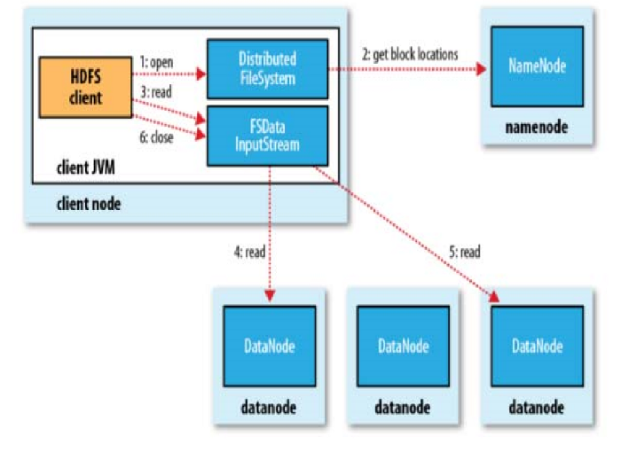
Implementation of File Read Operation

Slide 20
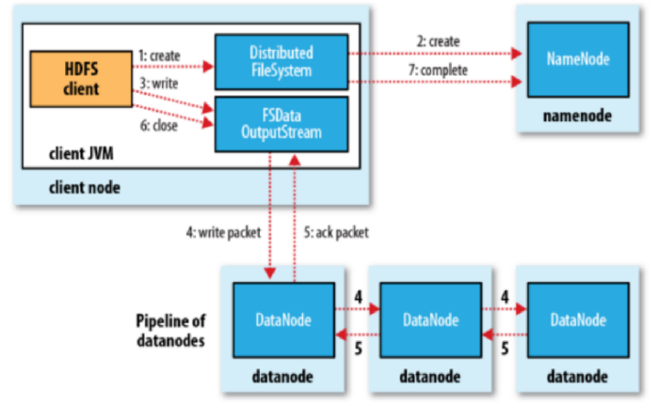
Implementation of File Write Operation

Slide 21
Namenode Redundancy
An additional secondary namenode can be implemented
When the primary namenode crashes, the secondary namenode will take over (i.e., namenode failover)
Two types of namenode failover
Pre-release 2 namenode failover
Release 2 namenode failover

Slide 22
Pre-release 2 Namenode Failover
The fsimage and edits files are used to recover from namenode failures
The fsimage and edits files will be persisted to multiple filesystems (e.g. local and NFS)
The secondary namenode periodically merge the fsimage file with the edits file (like taking a checkpoint) so that the edits files will not become too big.
Whenever the namenode fails, the following steps are performed to recover from the failure
The administrator will manually start another namenode
The fsimage and edits files are copied from the NFS filesystem
Change all datanodes to be aware of the new namenode
Datanodes will send block reports to the new namenode
It would take some time until the recover process is completed

Slide 23
Release 2 Namenode Failover
Release 2 HA feature tried to automate the recover process so improve the HDFS availability
A standby namenode runs side-by-side with the primary namenode
It constantly gets the updates of fsimage and edits files made by the primary namenode
All datanodes need to send the block reports to both primary and standby namenode now
Since the standby namenode get the latest updates in near real-time fashion, the system can perform the failover operation almost immediately

